Slide 1
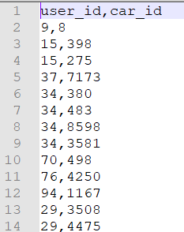

Slide 2
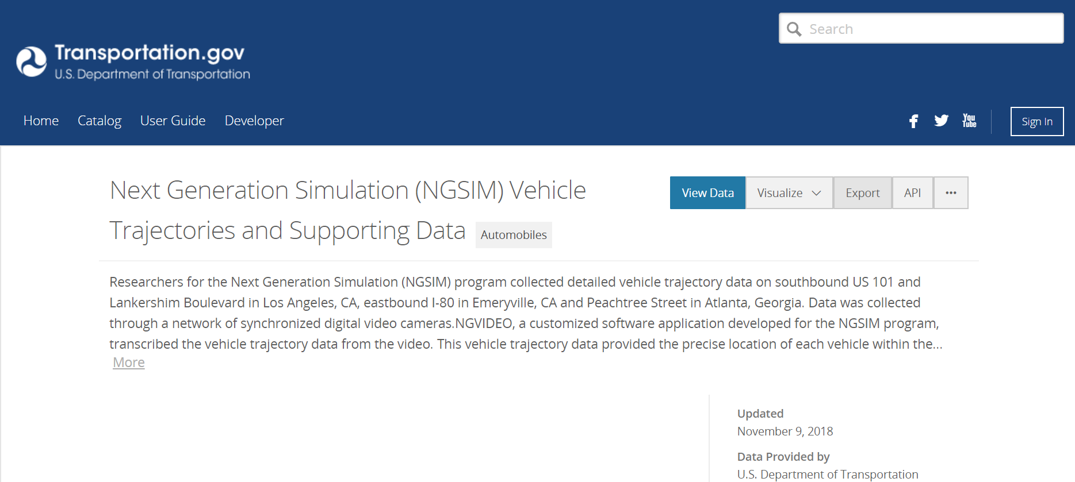
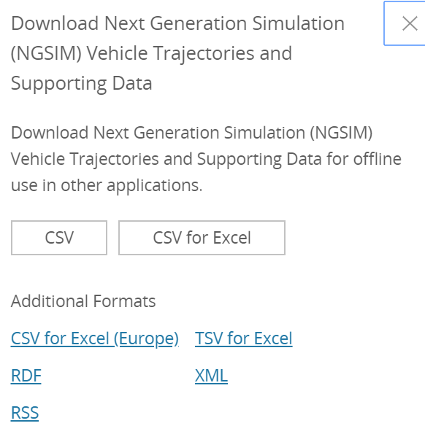

Slide 3
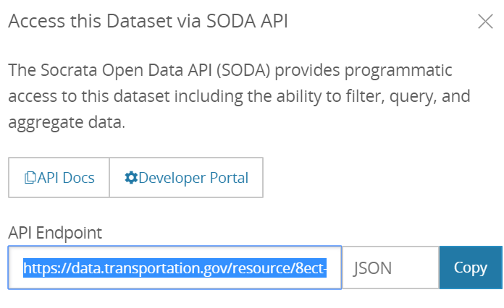

Slide 4
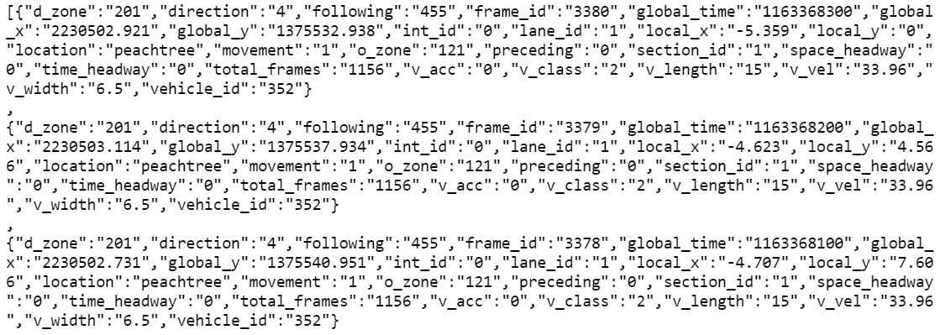

Slide 5
Find more mixed-traffic papper, in transportation not robot
Umich
TRB zhenyu account
No function/json/shapefile part in the first pre
Edit line-by-line, or they will learn nothing
Slow the installation step by step
The link of the NGSIM data
The intel data
NEWYORK shapefile

